Slide 1

Annotating predicates for the Mandarin conversation project

Slide 2
JSON file
Import tag_step2.json into your file, similar to what you did with tag_step1.json

Slide 3
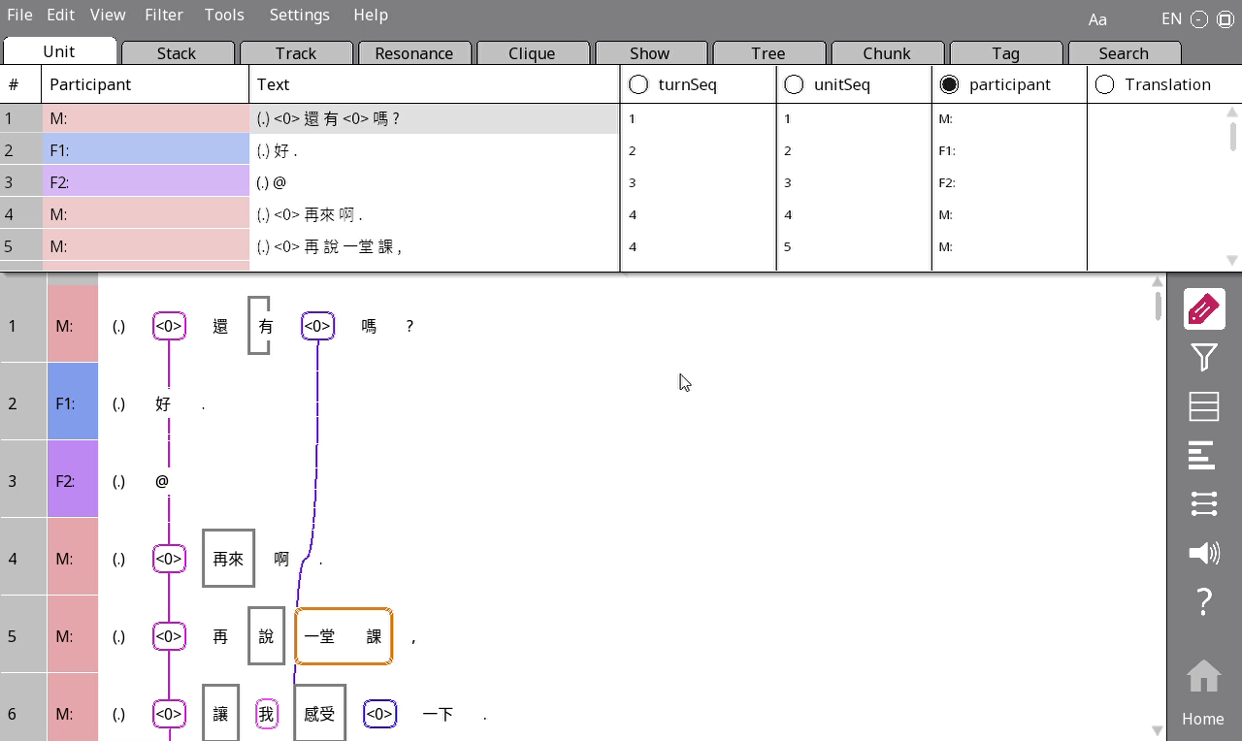
Translating units
Go to Unit > Translation for this
You technically only need to translate lines (intonation units) where there is a subject, but most lines will have one, so it’s probably easier to just translate everything

Slide 4
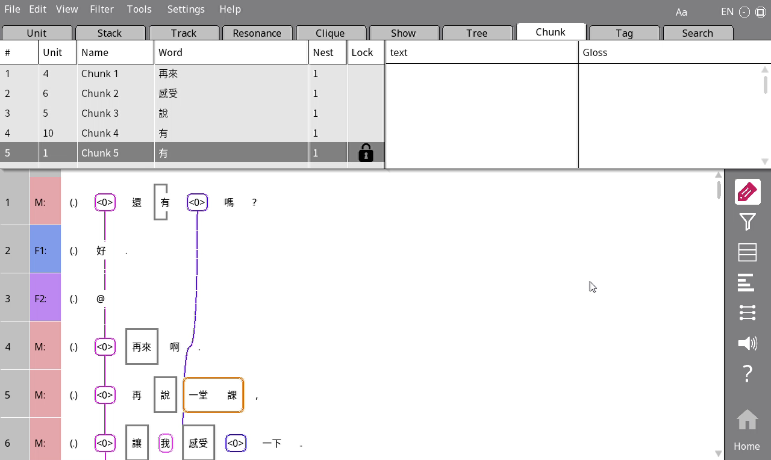
Translating predicates
Translate the verb in the Gloss column within Chunks.
Just put all the verbs in the present tense. No need to use the correct tense.

Slide 5
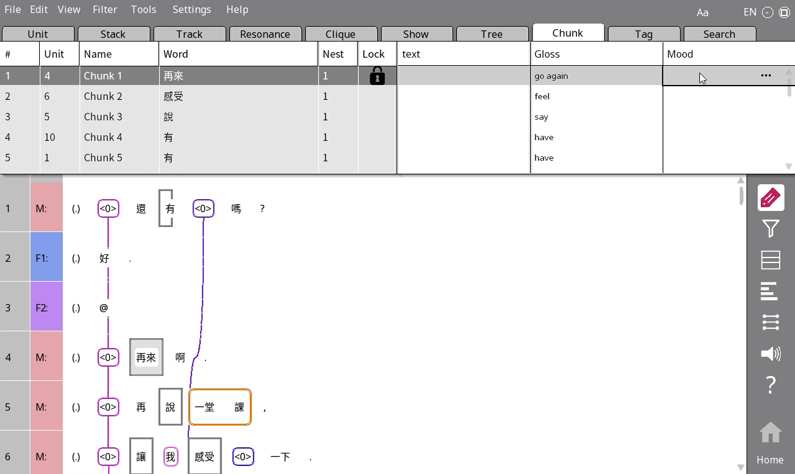
Identifying moods
If the verb belongs to an imperative (i.e. command), put the letter I under Mood.
Otherwise put C.

Slide 6
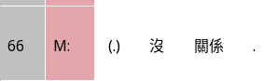
Impersonal
If a verb is impersonal, i.e. there is no real subject (e.g. 今天很熱), put Y there.
Otherwise put N. (You can leave blank if it’s N; we’ll add the Ns back programmatically)

Slide 7
FAlseStart
Put Y under FalseStart if the verb is part of something that was not finished, e.g. 我喜歡- 我喜歡吃蘋果

Slide 8
General idea of integration annotation
Integration = When people figure out what the subject of this refers to, do they do this with reference to arguments of other verbs in the same sentence?

Slide 9
Integration
Step 1: Is the verb in the same clause (小句) as another verb, and has its subject determined by that other verb?
Obligatory_Coref (M): Grammatically, the two verbs are integrated into one clause, where the argument in the first verb is always the subject of the second verb. E.g. 我幫你找考古題 – the subject of 找 is always the subject of 幫, we can’t have a situation where we say 我幫你找考古題 but the person who does the searching is the 你. So we put M for 找.
No_Obligatory_Coref (N): Similar to M, but coreference is not necessary. E.g. 我想去 vs 我想你去 – the 去 is N in the first case, because 想 doesn’t mean necessarily that the subject of 想 is the same as the subject of 去. In the second case, we need to go to the following steps.

Slide 10
Integration
Step 2: Does the verb belong to a complex sentence, and we determine what the subject refers to with reference to this other part of the complex sentence?
Subordinate (從屬關係, S): If the two clauses have unequal status, and the interpretation of the then you should tag the subordinate clause with this. 如果想去的話，你就去吧。 想 should be tagged S
This includes relative clauses: <0>喜歡上學的人 > 上學 should be tagged as S
Coordinate (並列關係, C): The two clauses have equal status and are separated by a conjunction (連詞). 他喜歡吃蘋果，而且每天都吃。

Slide 11
Integration
Step 3: Is the verb an answer to the previous clause?
Answer (A): The current clause is an answer to the previous clause. E.g. 你喜歡吃蘋果嗎? 喜歡.
Step 4: Any other case: D (No integration).

Slide 12
Integration examples
我 很 喜歡 <0> 看 電影， 因為 <0> 很 好看
D
N
S
<0> 講述 人民 生活 的 電影， 我 都 愛 <0> 看 。
S
Ｄ
Ｍ
如果 你 想 <0> 去 <0> 看 的話，就 <0> 去 吧。
Ｄ
N
M
D

